Slide 1
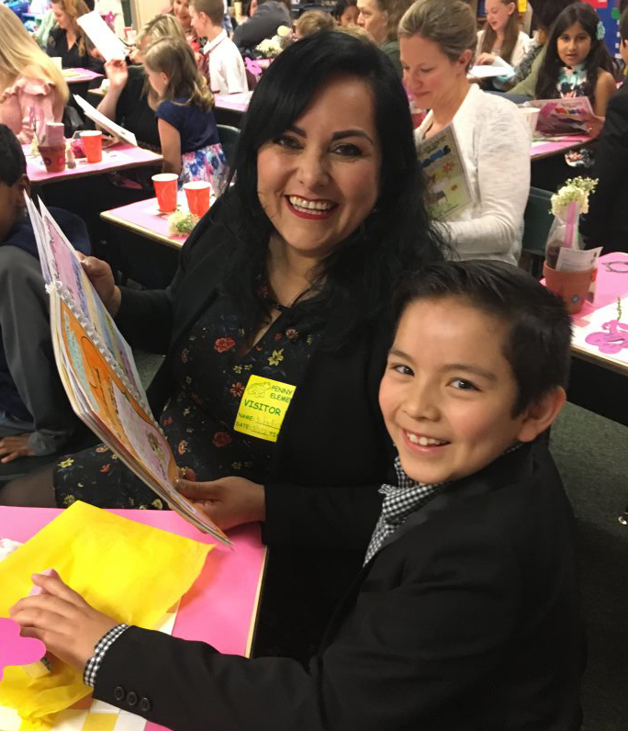
Welcome to Everett Public Schools

Slide 2

How many of these facts do you know?

Slide 3

95.7% of students graduate on time!

Slide 4

Everett Public Schools has one of the highest graduation rates in the state.

Slide 5

1,980 high school students took Advanced Placement classes in 2017-18.

Slide 6
Continued increase in Advanced Placement enrollment.
# of students taking AP class
# of students taking AP test
# of tests taken
2013-14
2014-15
2015-16
2016-17
2017-18

Slide 7

Moody’s upgraded the district’s bond rating to Aa1 and the outlook is stable. This saves taxpayers money over time.

Slide 8
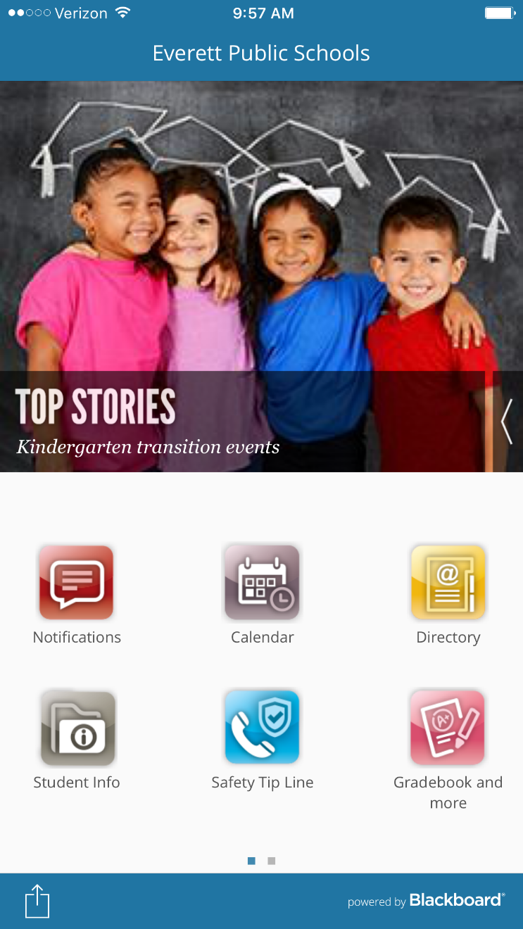
We have
an app!
Search for Everett Public Schools in your app store.

Slide 9

Over 90 languages are spoken by students in Everett Public Schools.

Slide 10
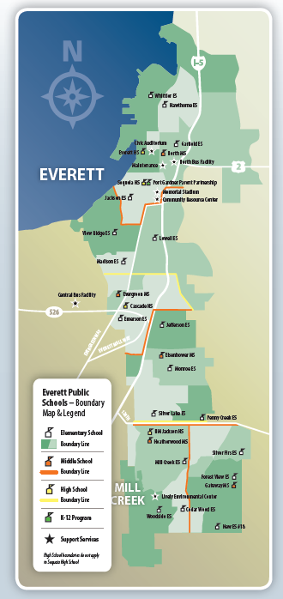
We are one of the fastest growing districts in the county.
20,079 students now, 1,858 more expected by 2026.

Slide 11
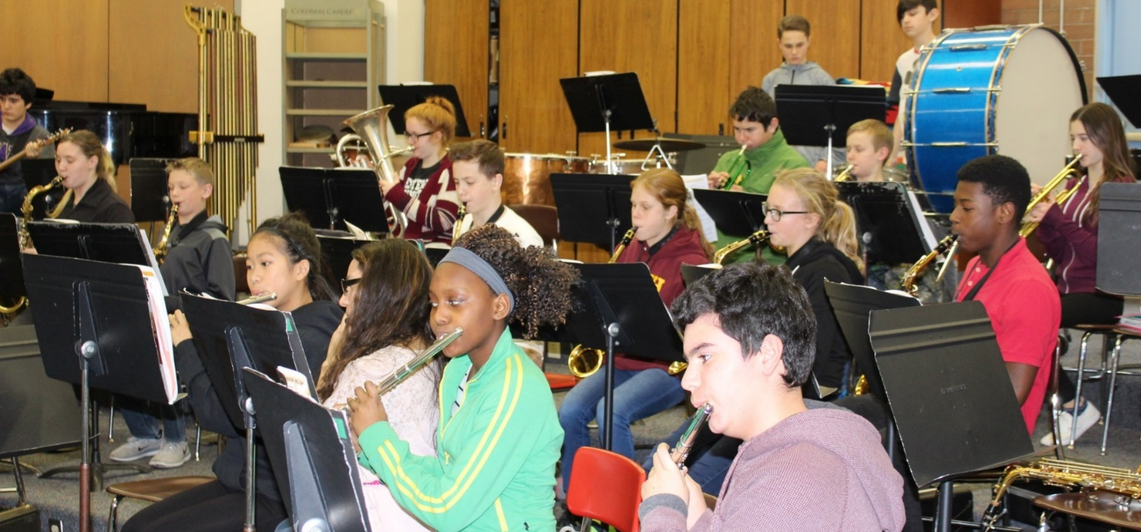
We partner with Music4Life to put gently-used music instruments into the hands of students in district music programs.

Slide 12

EPS has earned
AP District Honor Roll once again

Slide 13
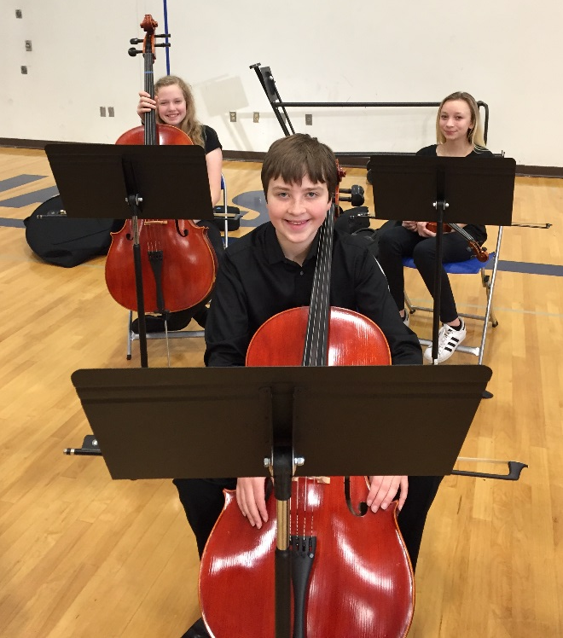
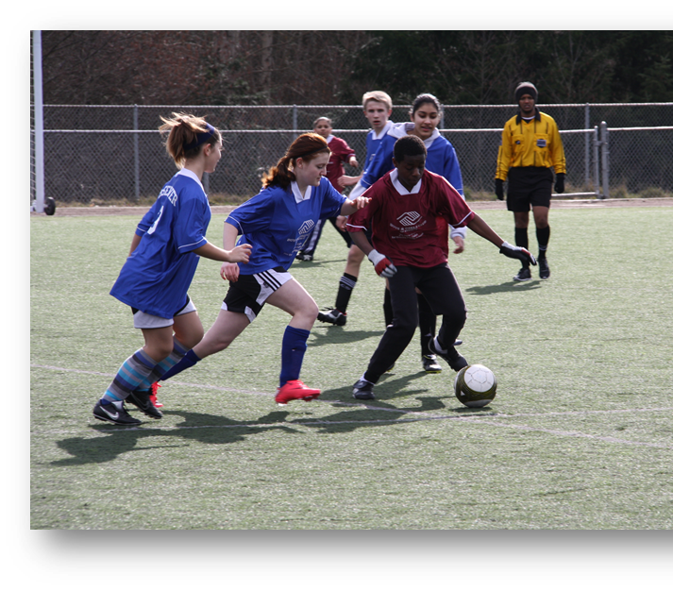
Students’ interests are supported
Orchestra
Performing arts
STEM
Athletics
Activities
One-to-one technology

Slide 14
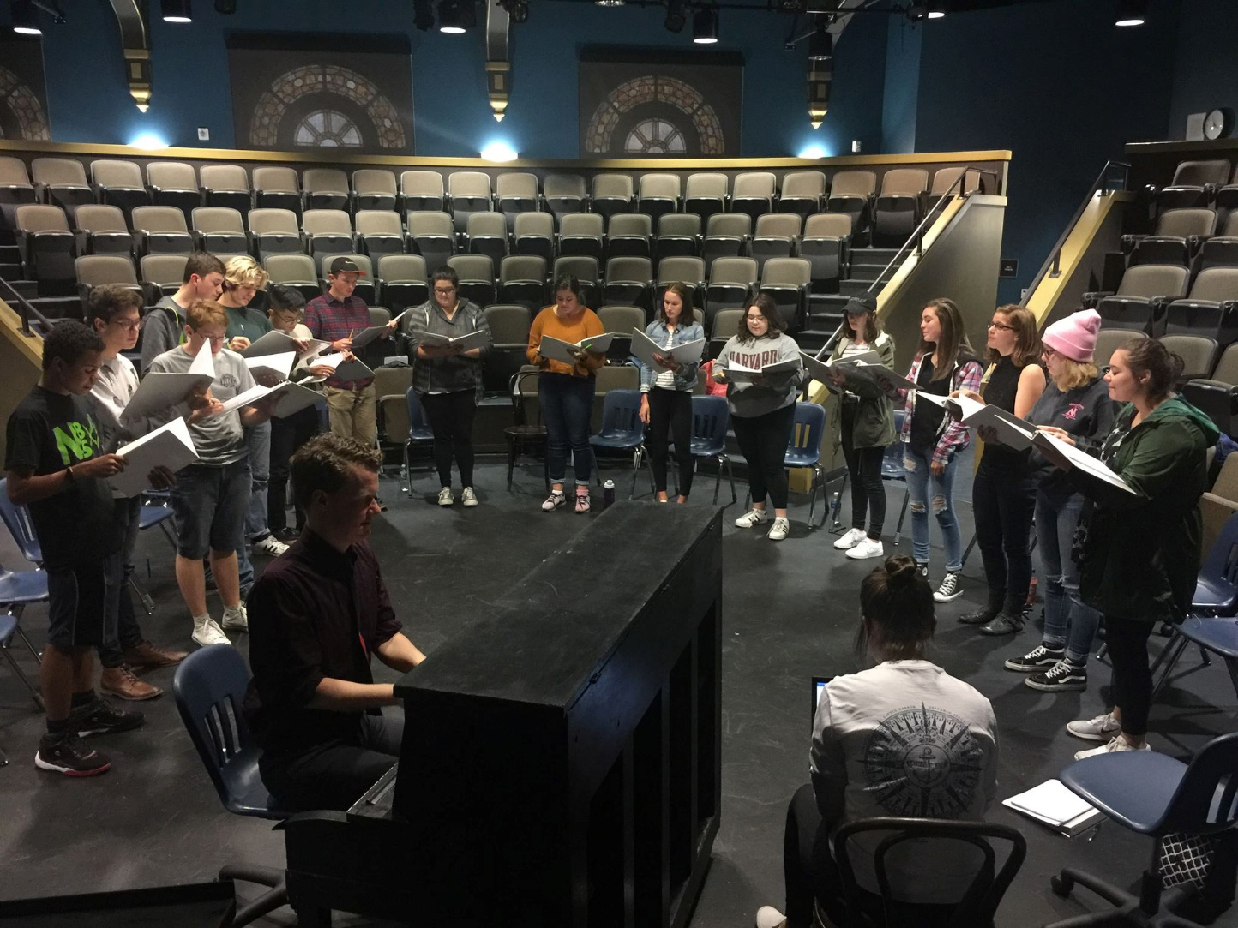
Students’ talents shine!

Slide 15
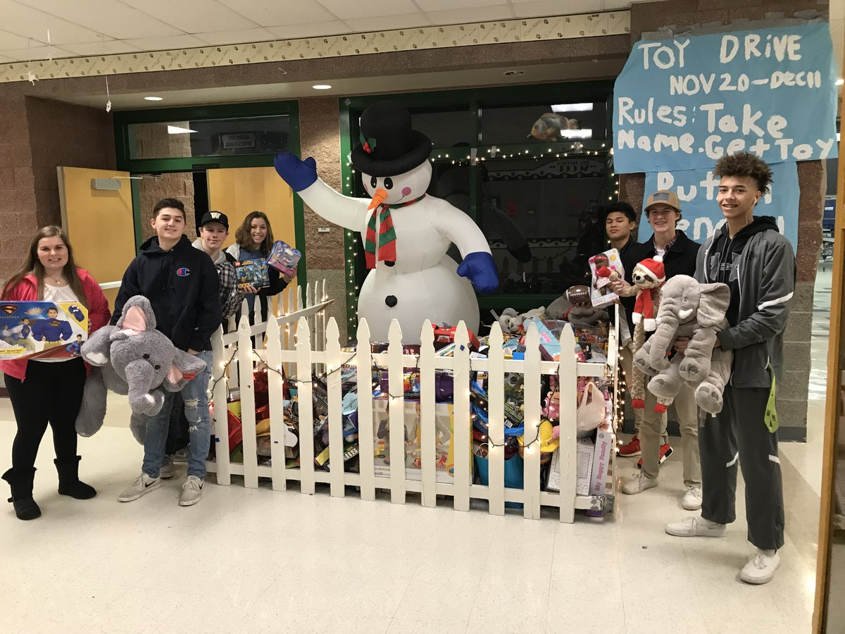
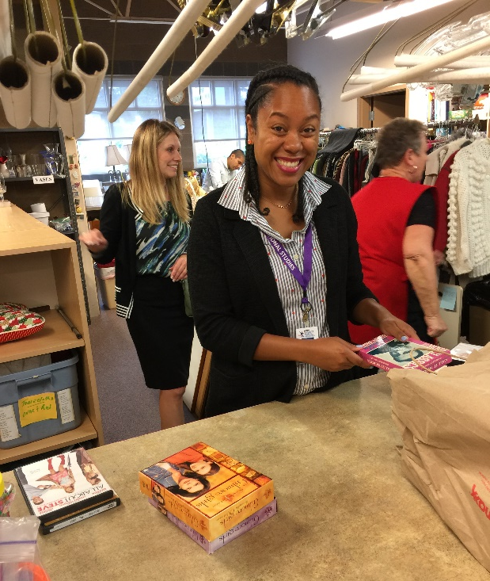
Community service is important to staff and students

Slide 16
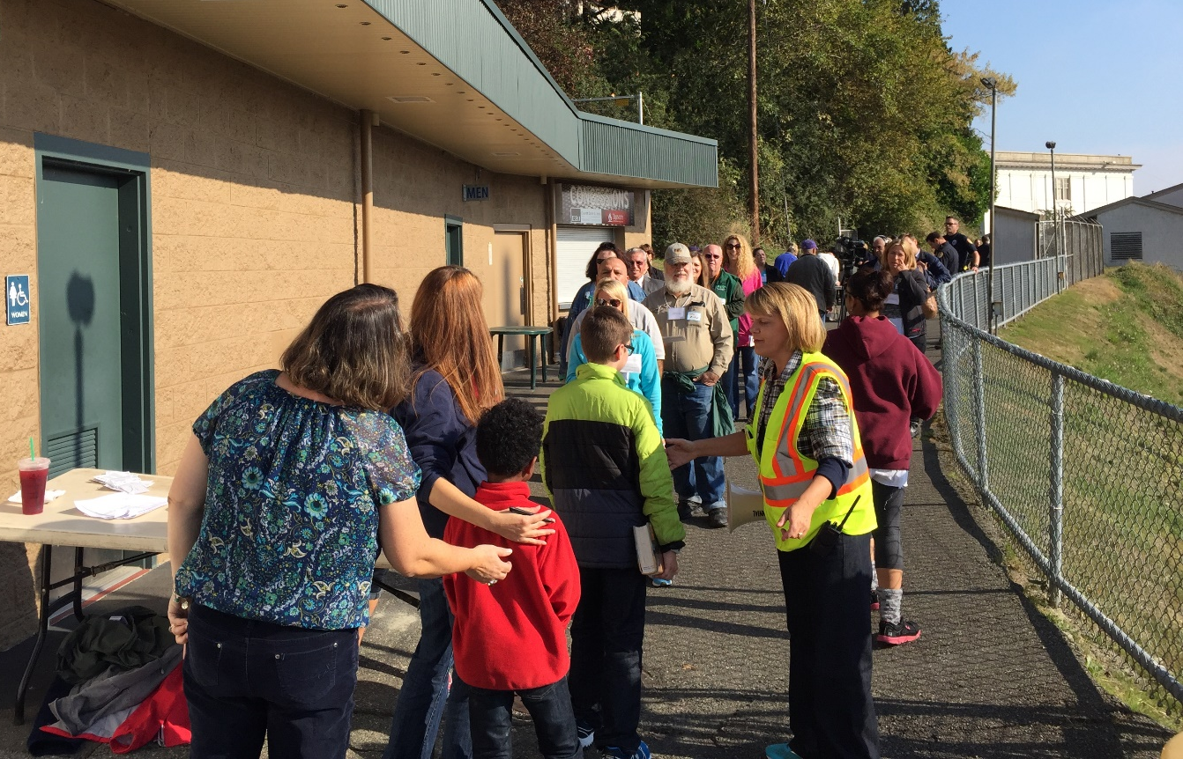
We focus on physical safety

Slide 17
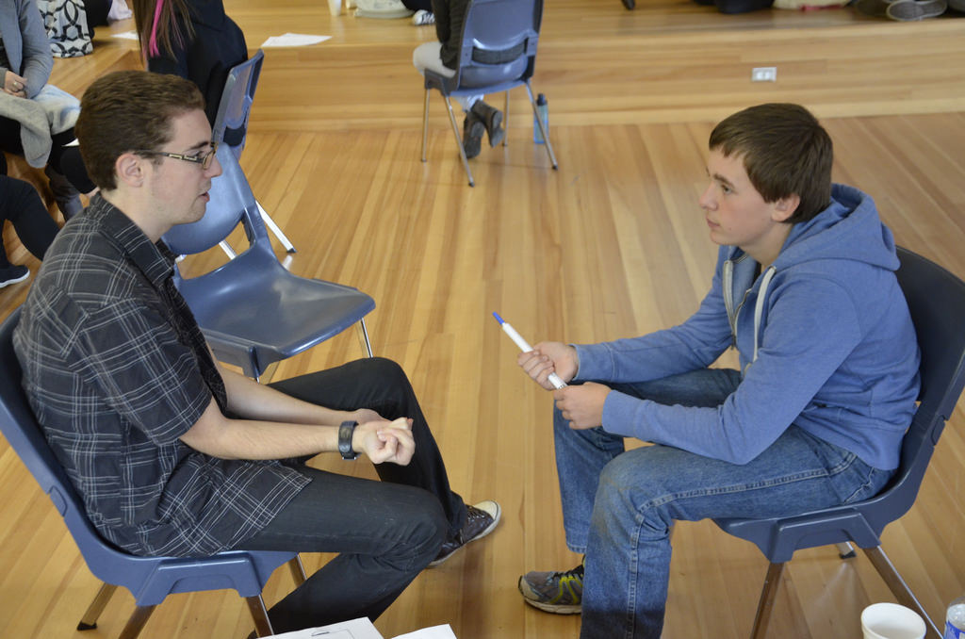
… and emotional safety

Slide 18
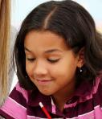
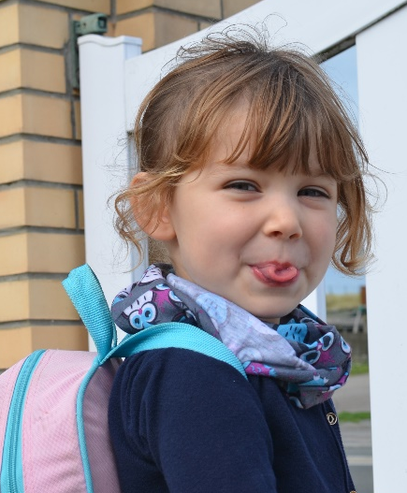

Over 1/3 of EPS students live in poverty
Over 1,600 homeless students last year –
enough to fill 3 elementary schools

Slide 19
District residents aged 60+ are eligible for free admission to some school sporting and performance events.
Call 425-385-4041 or see our website about the Senior PEP Club.

Slide 20
Assessment scores surpass the state … again!
Difference between percentage of district students meeting standard and the state percentages.
2018 | ELA | Math | Science
Grade 3 | +10.7 | +10.0
Grade 4 | +13.4 | +13.5
Grade 5 | +13.0 | +13.4 | +12.0
Grade 6 | +11.1 | +7.3
Grade 7 | +12.1 | +5.7
Grade 8 | +13.6 | +8.4 | +9.6
Grade 10 | +5.7 | +2.3
Grade 11 |  |  | +9.9

Slide 21
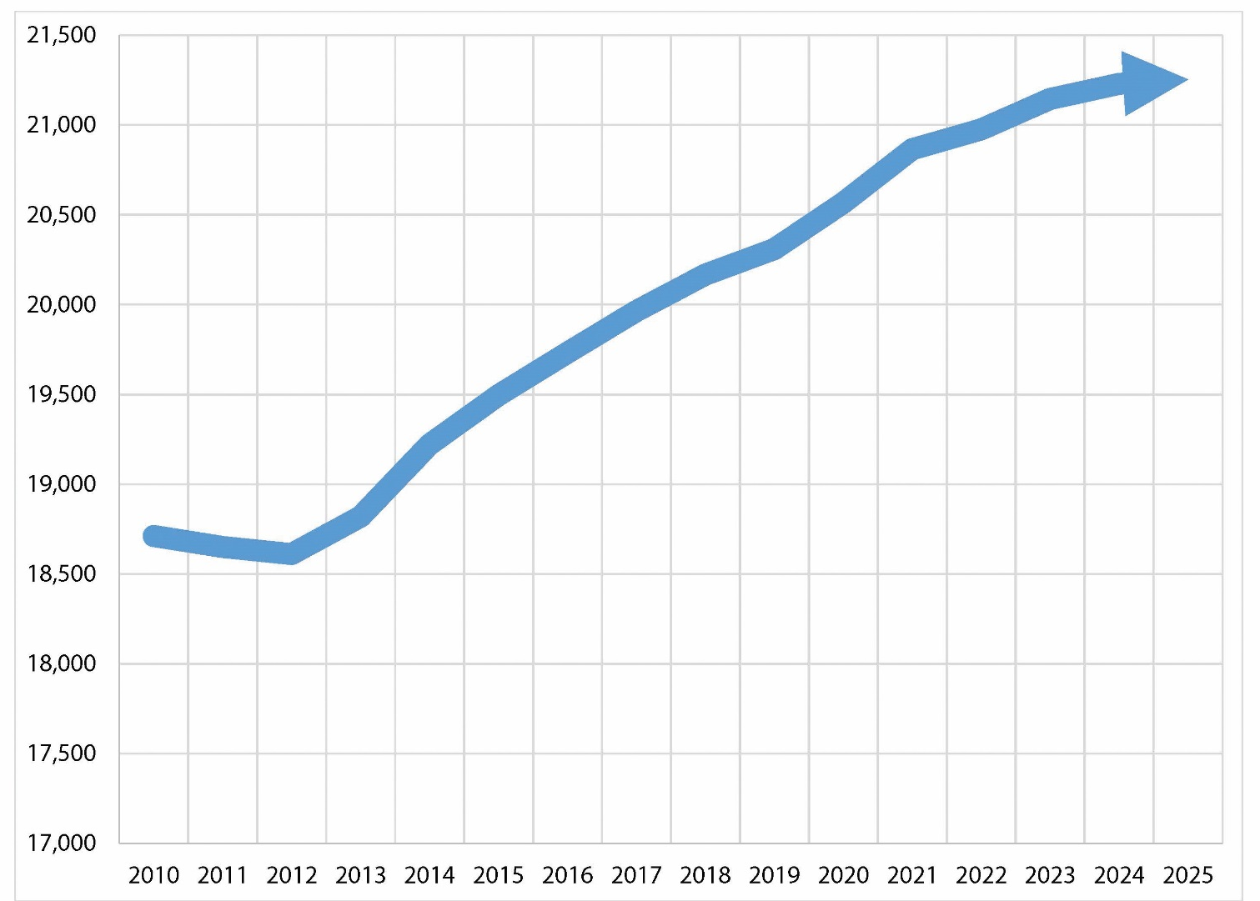
Snohomish County is one of the fastest growing areas in WA
Nearly 1,858 more students are expected by 2026.

Slide 22
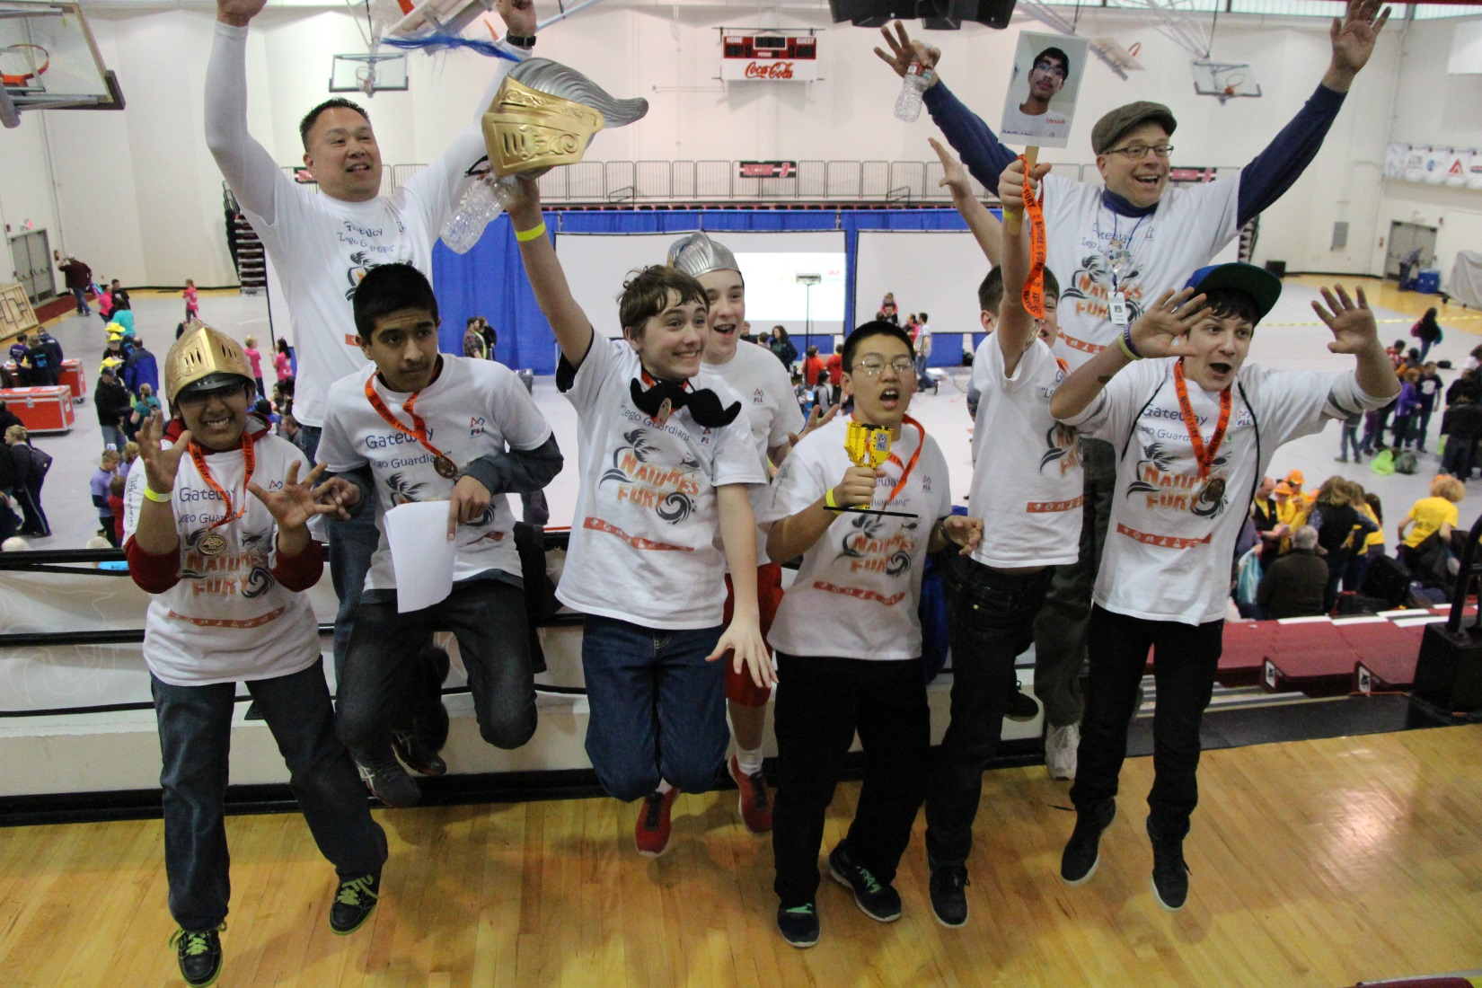
Each school has a robotics program.

Slide 23
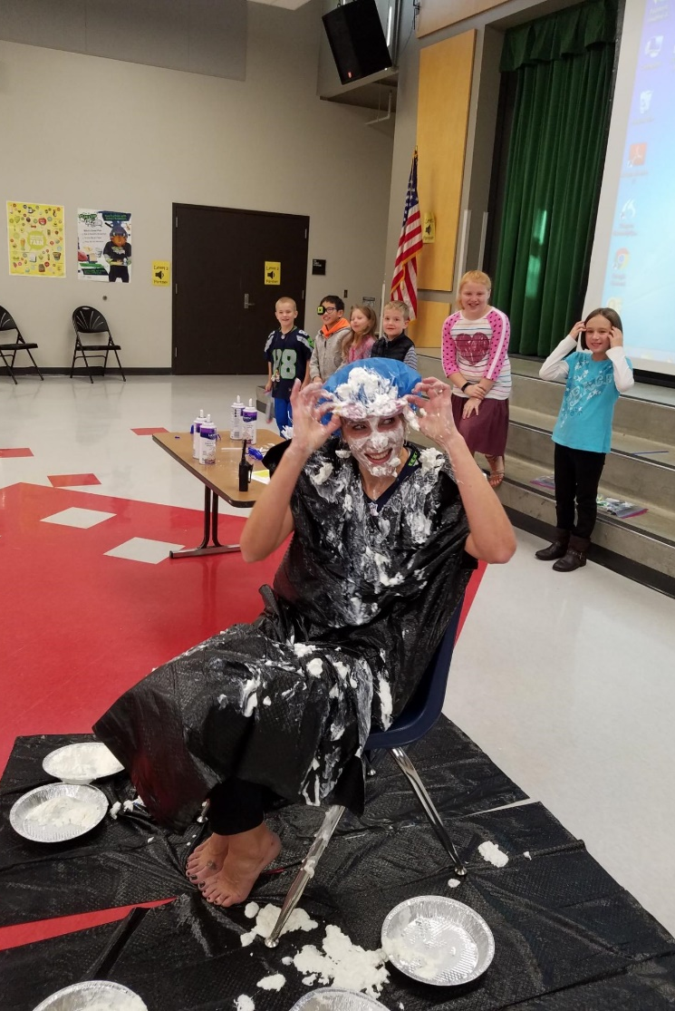
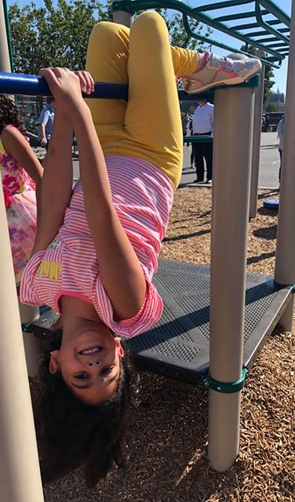
We laugh together … a lot!

Slide 24
Insert a fact about your school
Insert answer here

